Slide 1
Intro to MQTT… with something of REST
Pietro Manzoni
Universitat Politecnica de Valencia (UPV)
Valencia - SPAIN
pmanzoni@disca.upv.es

Slide 2



Universitat Politècnica de València
The Universitat Politècnica de València (UPV) is a Spanish public educational institution founded in 1968.
Its academic community comprises 36.823 students, almost 2.661 lecturers and researchers, and 1.422 administration and services professionals.
It has three campuses: the main one in the city of Valencia and the other two in Alcoy and Gandia.
The Vera Campus covers around 840.000 m² and is almost 2 km long. It is a pedestrian campus with over 123.000 m² of green areas.
UPV is composed of 10 schools, 3 faculties and 2 higher polytechnic schools.

Slide 3
From “byte streams” to “messages”
The “old” vision of data communication was based on reliable byte streams, i.e., TCP
Nowadays messages interchange is becoming more common
E.g., Twitter, Whatsapp, Instagram, Snapchat, Facebook,...
Actually is not that new…
emails: SMTP+MIME,
FTP,
uucp

Slide 4
Interchanging messages: request/response paradigm
REST: Representational State Transfer
Widely used; based on HTTP
Lighter version: CoAP
Server

Slide 5

Interchanging message: pub/sub paradigm
Publish/Subscriber
aka: producer/consumer
Growing paradigm
E.g., https://cloud.google.com/iot/docs/how-tos/mqtt-bridge
Various solutions
MQTT, AMQP, XMPP (was Jabber)
HiveMQ©

Slide 6
Data Representation
{“value": 237} vs. <value>237</value>
Data-interchange format: (1) should be easy for humans to read and write, and (2) should be easy for machines to parse and generate
Two main formats:
JavaScript Object Notation (JSON) [http://www.json.org/] {"menu": { "id": "file", "value": "File", "popup": { "menuitem": [ {"value": "New", "onclick": ”NewDoc()"}, {"value": "Open", "onclick": "OpenDoc()"}, {"value": "Close", "onclick": "CloseDoc()"} ] } } } | XML <menu> <id>file</id> <value>File</value> <popup> <menuitem> <value>New</value> <onclick>NewDoc()</onclick> </menuitem> <menuitem> <value>Open</value> <onclick>OpenDoc()</onclick> </menuitem> <menuitem> <value>Close</value> <onclick>CloseDoc()</onclick> </menuitem> </popup> </menu>

Slide 7
JSON and Python
>>> import json
>>> d = {'sensorId': 'temp1', 'Value': 25}
>>> d
{'sensorId': 'temp1', 'Value': 25}
>>> d['sensorId']
'temp1'
>>> dj = json.dumps(d)
>>> dj
'{"sensorId": "temp1", "Value": 25}'
>>> nd = json.loads(dj)
>>> nd
{u'sensorId': u'temp1', u'Value': 25}
>>> nd['sensorId']
u'temp1'

Slide 8
REST: Representational State Transfer

Slide 9
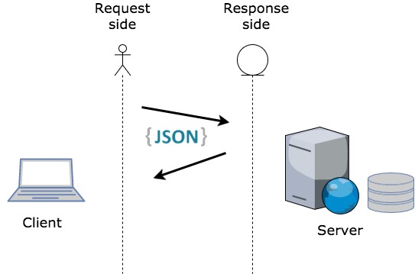
REST and HTTP
REST stands for Representational State Transfer.
It basically leverages the HTTP protocol and its related frameworks to provide data services.
The motivation for REST was to capture the characteristics of the Web which made the Web successful.
Make a Request – Receive Response – Display Response
REST is not a standard… but it uses several standards:
HTTP
URL
Resource Representations: XML/HTML/GIF/JPEG/etc
Resource Types, MIME Types: text/xml, text/html, image/gif, image/jpeg, etc

Slide 10
REST is widely used
Twitter:
https://developer.twitter.com/en/docs/basics/getting-started
Facebook:
https://developers.facebook.com/docs/graph-api
Amazon offers several REST services, e.g., for their S3 storage solution
https://docs.aws.amazon.com/AmazonS3/latest/API/Welcome.html
Tesla Model S uses an (undocumented) REST API between the car systems and its Android/iOS apps.
https://timdorr.docs.apiary.io/#
Google Maps:
https://developers.google.com/maps/web-services/
Try: http://maps.googleapis.com/maps/api/geocode/json?address=lecco

Slide 11
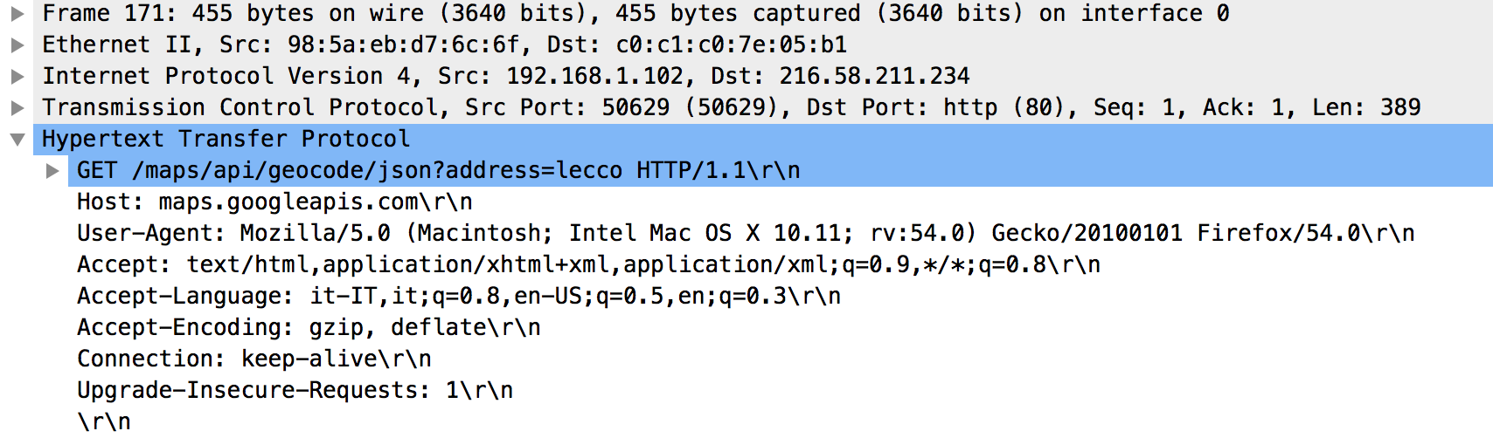
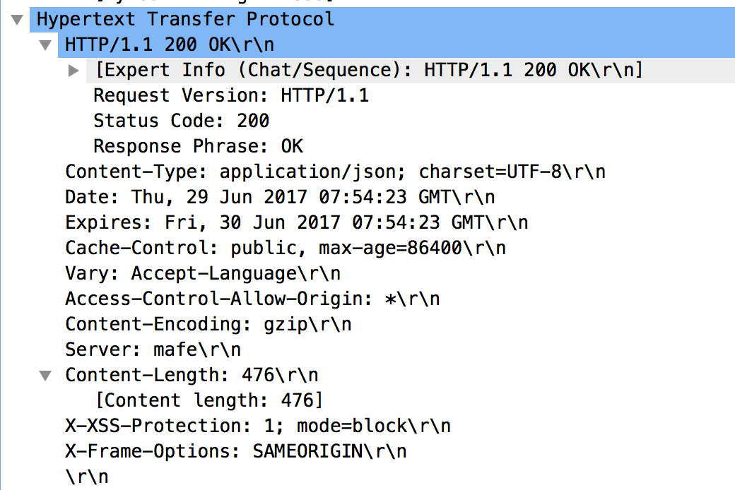
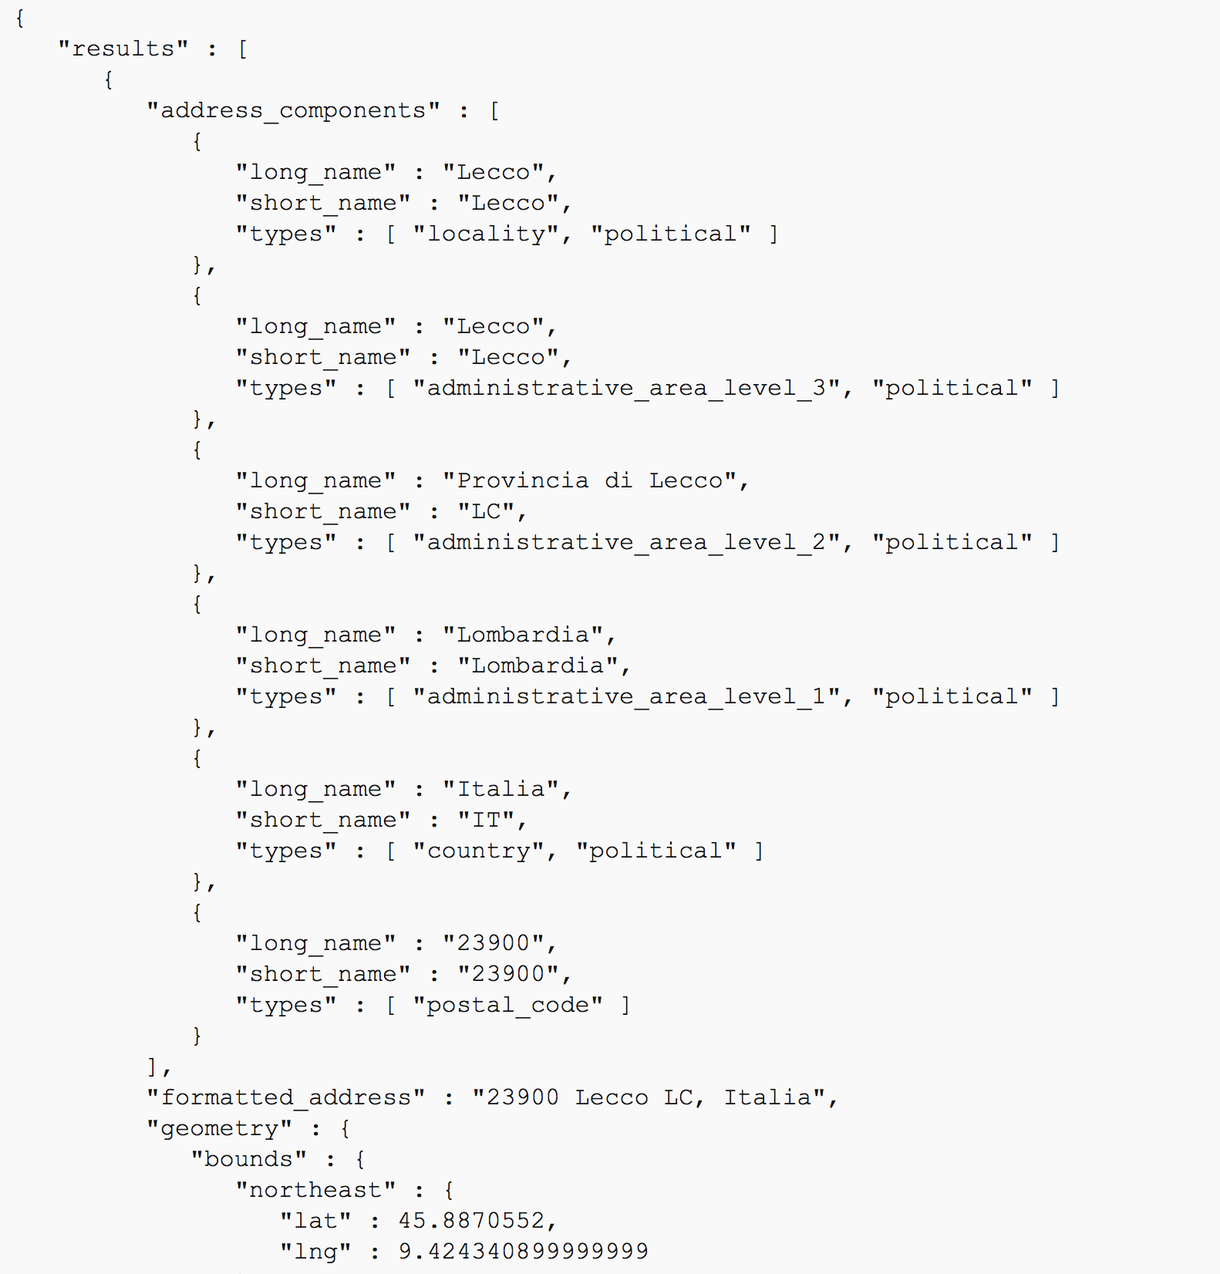
The Wireshark view

Slide 12
REST: the resources
The key abstraction of information in REST is a resource.
A resource is a conceptual mapping to a set of entities
Any information that can be named can be a resource: a document or image, a temporal service (e.g. "today's weather in Los Angeles"), a collection of other resources, a non-virtual object (e.g. a person or a device), and so on
Represented with a global identifier (URI in HTTP). For example:
http://www.acme.com/device-management/managed-devices/{device-id}
http://myhome.com/api/states/livingroom/sensor1/temperature
http://www.potus.org/user-management/users/{id}
http://www.library.edu/books/ISBN-0011/authors
As you traverse the path from more generic to more specific, you are navigating the data

Slide 13


REST for devices control
GET /status/power
all-lights.floor-d.example.com
PUT /control/onoff
PUT /control/color #00FF00

Slide 14
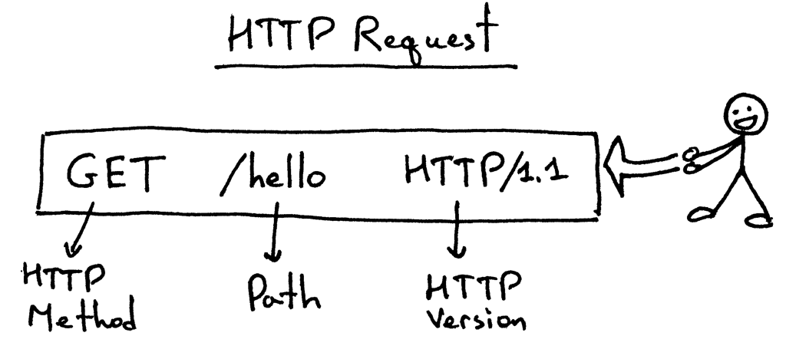
Actions
Represent the operations that can be performed on the resources
HTTP GET
HTTP POST
HTTP PUT
HTTP DELETE

Slide 15
Running example of a resource: a ‘todo’ list
>>> tasks
[
{'id': 2345, 'summary': 'recipe for tiramisu’, 'description': 'call mom and ask...’},
{'id': 3657, 'summary': 'what to buy today’, 'description': '6 eggs, carrots, spaghetti’}
]
>>> tasks[1]['id']
2345
>>> tasks[1]
{'id': 2345, 'summary': 'recipe for tiramisu’, 'description': 'call mom and ask...’}

Slide 16
HTTP GET
How clients ask for the information they seek.
Issuing a GET request transfers the data from the server to the client in some representation (JSON, XML, …)
GET /tasks/
Return a list of items on a todo list, in the format {"id": <item_id>, "summary": <one-line summary>}
GET /tasks/<item_id>/
Fetch all available information for a specific todo item, in the format {"id": <item_id>, "summary": <one-line summary>, "description" : <free-form text field>}

Slide 17
HTTP PUT, HTTP POST
HTTP POST creates a resource
HTTP PUT updates a resource
POST /tasks/
Create a new todo item. The POST body is a JSON object with two fields: “summary” (must be under 120 characters, no newline), and “description” (free-form text field).
On success, the status code is 201, and the response body is an object with one field: the id created by the server (e.g., { "id": 3792 }).
PUT /tasks/<item_id>/
Modify an existing task. The PUT body is a JSON object with two fields: “summary” (must be under 120 characters, no newline), and “description” (free-form text field).

Slide 18
HTTP PATCH
PATCH is defined in RFC 5789. It requests that a set of changes described in the request entity be applied to the resource identified by the Request- URI. Let's look at an example:
{
'id': 3657,
'summary': 'what to buy today’,
'description': '6 eggs, carrots, spaghetti’
}
If you want to modify this entry, you choose between PUT and PATCH. A PUT might look like this:
PUT /tasks/3657/
{
'id': 3657,
'summary': 'what to buy today’,
'description': '6 eggs, carrots, spaghetti, bread’
}
You can accomplish the same using PATCH:
PATCH /tasks/3657/
{
'description': '6 eggs, carrots, spaghetti, bread’
}
The PUT included all of the parameters on this user, while PATCH only included the one that was being modified.

Slide 19
HTTP DELETE
Removes the resource identified by the URI
DELETE /tasks/<item_id>/
Mark the item as done. (I.e., strike it off the list, so GET /tasks/ will not show it.)
The response body is empty.

Slide 20
MQTT
Basic concepts
Basic programming
Source: https://zoetrope.io/tech-blog/brief-practical-introduction-mqtt-protocol-and-its-application-iot

Slide 21

Message Queuing Telemetry Transport
A lightweight publish-subscribe protocol that can run on embedded devices and mobile platforms ➔ http://mqtt.org/
The MQTT community wiki: https://github.com/mqtt/mqtt.github.io/wiki
A very good tutorial: http://www.hivemq.com/mqtt-essentials/
Designed to provide a low latency two-way communication channel and efficient distribution to one or many receivers.
Assured messaging over fragile networks
Maximum message size of 256MB
not really designed for sending large amounts of data
better at a high volume of low size messages.
Binary compress headers
Low power usage.

Slide 22
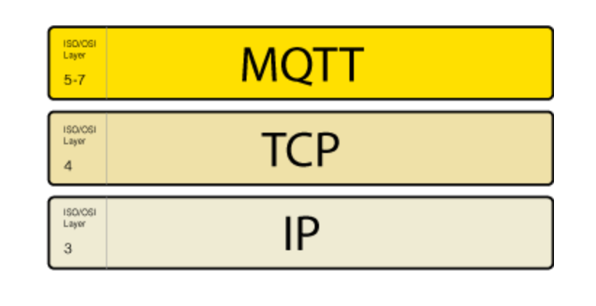
MQTT overview
MQTT is an open standard with a short and readable protocol specification.
October 29th 2014: MQTT was officially approved as OASIS Standard.
MQTT 3.1.1 is the current version of the protocol.
OASIS MQTT TC: https://www.oasis-open.org/committees/tc_home.php?wg_abbrev=mqtt
Standard document here:
http://docs.oasis-open.org/mqtt/mqtt/v3.1.1/mqtt-v3.1.1.html
Works on top of the TCP protocol stack
There is also the closely related MQTT for Sensor Networks (MQTT-SN) where TCP is replaced by UDP; TCP stack is too complex for WSN

Slide 23
MQTT Version 5
The next version of MQTT will be version 5
Currently (10 April 2018 ) in Draft 19
You can find the working drafts here:
https://www.oasis-open.org/committees/documents.php?wg_abbrev=mqtt&show_descriptions=yes
The key ideas in version 5 can be found here:
https://www.oasis-open.org/committees/download.php/57616/Big%20Ideas%20for%20MQTT%20v5.pdf
Basically:
Enhancements for Scalability and Large Scale Systems
Improved Error Reporting
Extensible Metadata
Added Support for Resource Constrained Clients and PerformanceImprovements
If you are wondering what happened to version 4 then see:
http://www.eclipse.org/community/eclipse_newsletter/2016/september/article3.php

Slide 24
Publish/subscribe pattern
Pub/Sub decouples a client, who is sending a message about a specific topic, called publisher, from another client (or more clients), who is receiving the message, called subscriber.
This means that the publisher and subscriber don’t know about the existence of one another.
There is a third component, called broker, which is known by both the publisher and subscriber, which filters all incoming messages and distributes them accordingly.
Publisher 1
Publisher 2
Broker
Subscriber 1
Subscriber 2
Subscriber 3

Slide 25
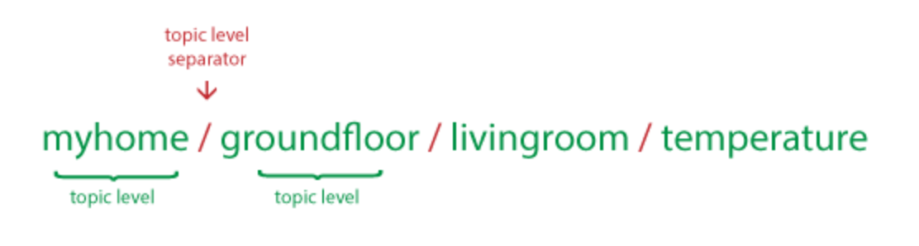
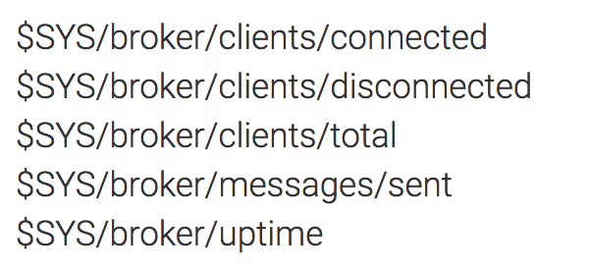
Topics
MQTT Topics are structured in a hierarchy similar to folders and files in a file system using the forward slash ( / ) as a delimiter.
Allow to create a user friendly and self descriptive naming structures
Topic names are:
Case sensitive
use UTF-8 strings.
Must consist of at least one character to be valid.
Except for the $SYS topic there is no default or standard topic structure.
Special $SYS/ topics

Slide 26
Topics wildcards
Topic subscriptions can have wildcards. These enable nodes to subscribe to groups of topics that don’t exist yet, allowing greater flexibility in the network’s messaging structure.
‘+’ matches anything at a given tree level
‘#’ matches a whole sub-tree
Examples:
Subscribing to topic house/# covers:
house/room1/main-light
house/room1/alarm
house/garage/main-light
house/main-door
Subscribing to topic house/+/main-light covers:
house/room1/main-light
house/room2/main-light
house/garage/main-light
but doesn’t cover
house/room1/side-light
house/room2/side-light

Slide 27
Topics best practices
First of all:
Don’t use a leading forward slash
Don’t use spaces in a topic
Use only ASCII characters, avoid non printable characters
Then, try to..
Keep the topic short and concise
Use specific topics, instead of general ones
Don’t forget extensibility
Finally, be careful and don’t subscribe to #

Slide 28
Publish/subscribe interactions sequence
Publisher
BROKER
Subscriber
connect
connect ACK
connect
connect ACK
subscribe (topic)
subscribe ACK
publish (topic, data)
publish (topic, data)

Slide 29
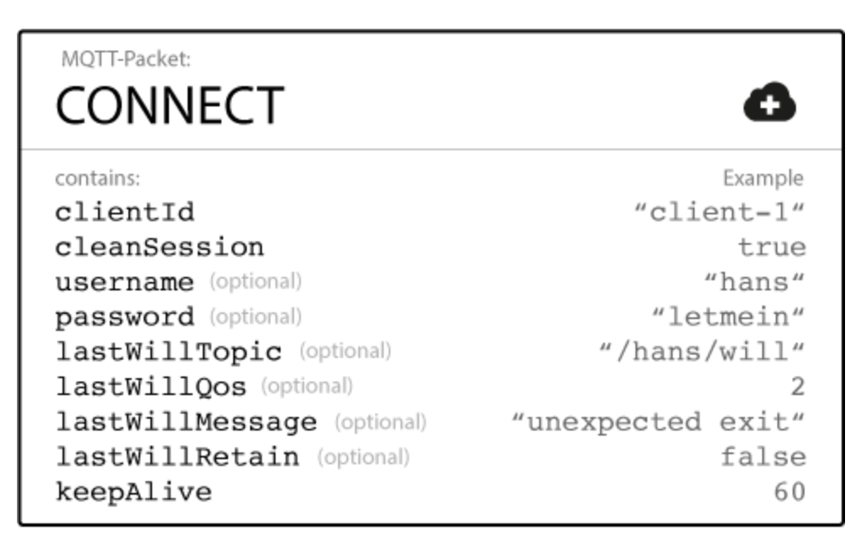
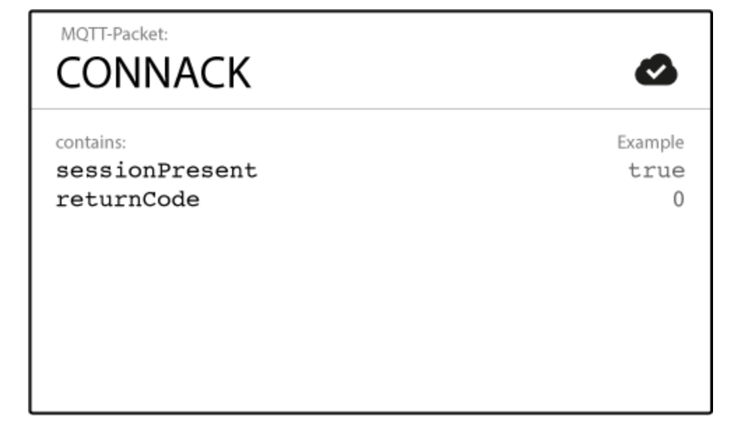

Connecting to the broker

Slide 30
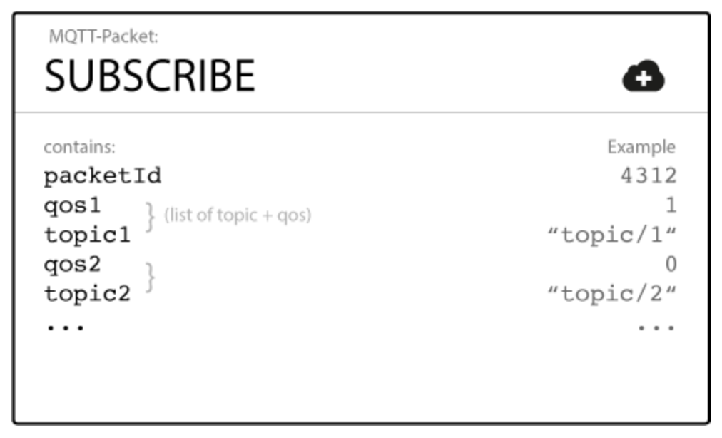
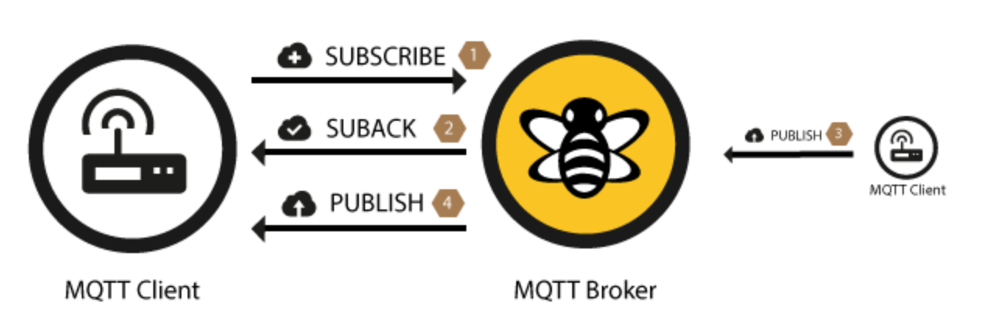
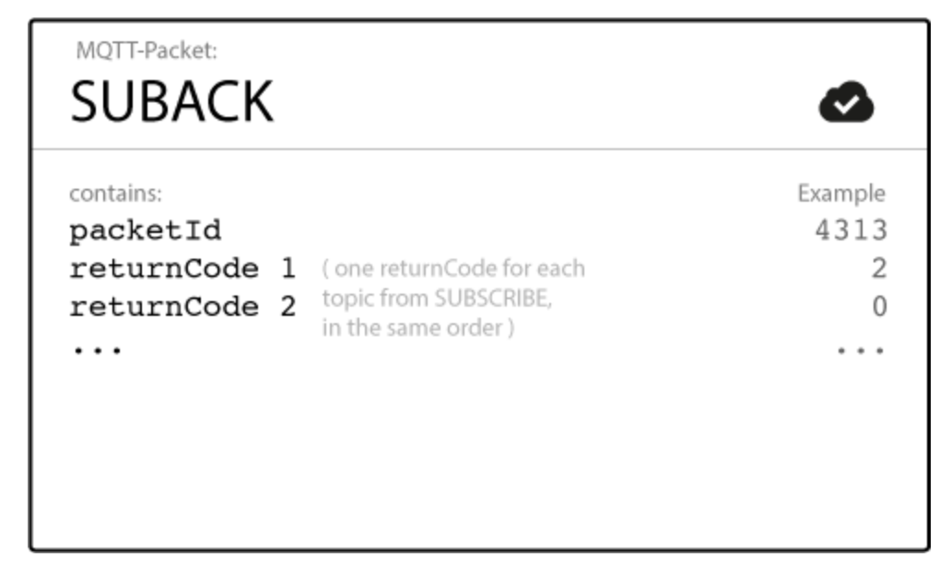
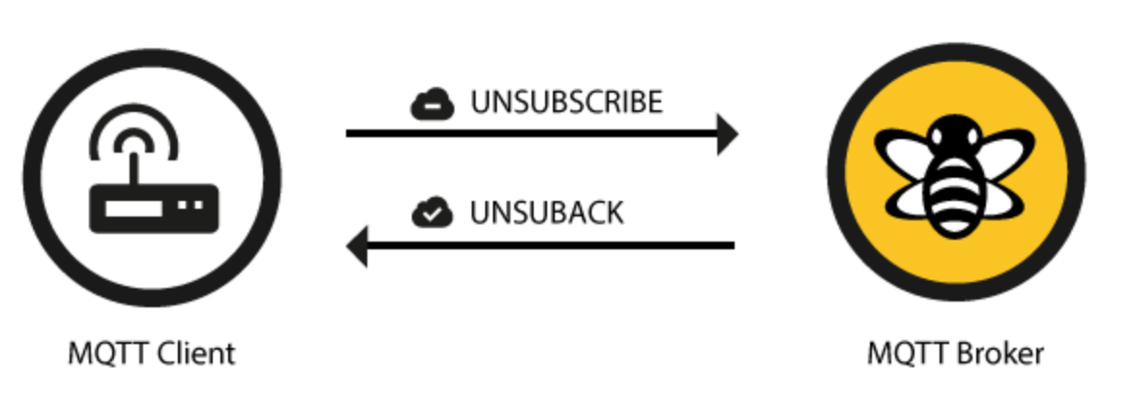
Subscribing

Slide 31
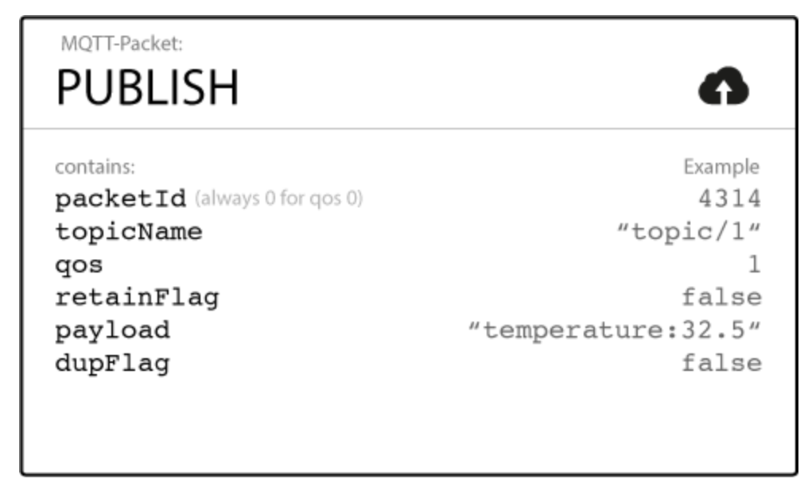
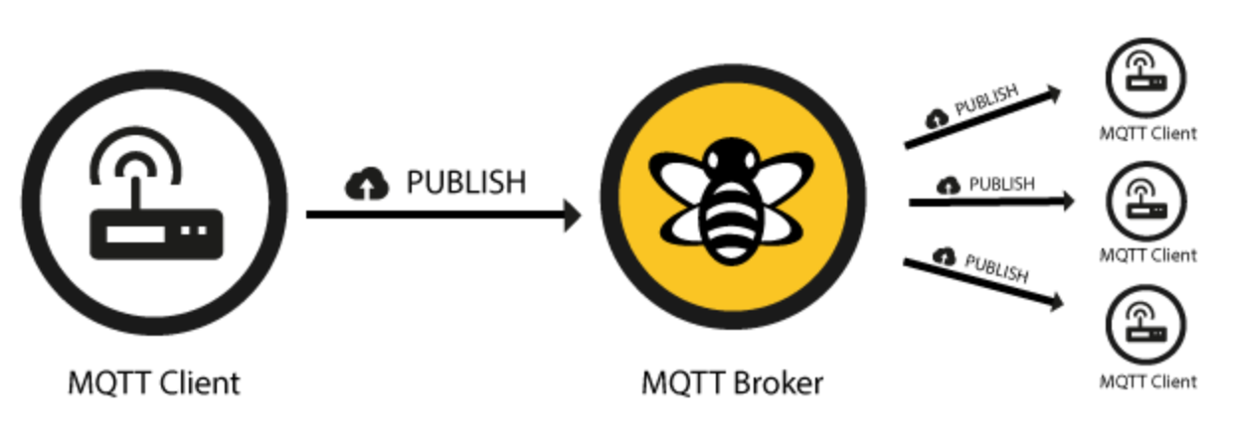
Publishing
MQTT is data-agnostic and it totally depends on the use case how the payload is structured. It’s completely up to the sender if it wants to send binary data, textual data or even full-fledged XML or JSON.

Slide 32
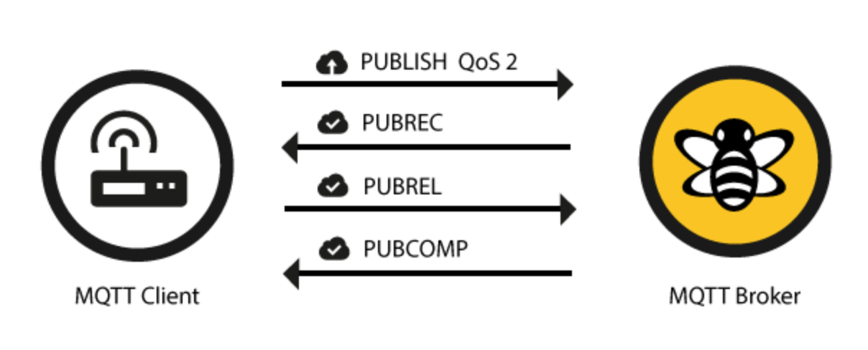
Quality of Service (QoS)
Messages are published with a Quality of Service (QoS) level, which specifies delivery requirements.
A QoS-0 (“at most once”) message is fire-and-forget.
For example, a notification from a doorbell may only matter when immediately delivered.
With QoS-1 (“at least once”), the broker stores messages on disk and retries until clients have acknowledged their delivery.
(Possibly with duplicates.) It’s usually worth ensuring error messages are delivered, even with a delay.
QoS-2 (“exactly once”) messages have a second acknowledgement round-trip, to ensure that non-idempotent messages can be delivered exactly once.

Slide 33
QoS: good to know
The QoS flows between a publishing and subscribing client are two different things and QoS can be different.
That means the QoS level can be different from client A, who publishes a message, and client B, who receives the published message.
If client B has subscribed to the broker with QoS 1 and client A sends a QoS 2 message, it will be received by client B with QoS 1. And of course it could be delivered more than once to client B, because QoS 1 only guarantees to deliver the message at least once.
Between the sender and the broker the QoS is defined by the sender.
B
A
MQTT

Slide 34
QoS: Best Practice
Use QoS 0 when …
You have a complete or almost stable connection between sender and receiver. A classic use case is when connecting a test client or a front end application to a MQTT broker over a wired connection.
You don’t care if one or more messages are lost once a while. That is sometimes the case if the data is not that important or will be send at short intervals, where it is okay that messages might get lost.
You don’t need any message queuing. Messages are only queued for disconnected clients if they have QoS 1 or 2 and a persistent session.
Use QoS 1 when …
You need to get every message and your use case can handle duplicates. The most often used QoS is level 1, because it guarantees the message arrives at least once. Of course your application must be tolerating duplicates and process them accordingly.
You can’t bear the overhead of QoS 2. Of course QoS 1 is a lot fast in delivering messages without the guarantee of level 2.
Use QoS 2 when …
It is critical to your application to receive all messages exactly once. This is often the case if a duplicate delivery would do harm to application users or subscribing clients. You should be aware of the overhead and that it takes a bit longer to complete the QoS 2 flow.
Queuing of QoS 1 and 2 messages
All messages sent with QoS 1 and 2 will also be queued for offline clients, until they are available again. But queuing is only happening if the client has a persistent session.

Slide 35
Retained Messages!!!
A retained message is a normal MQTT message with the retained flag set to true. The broker will store the last retained message and the corresponding QoS for that topic
Each client that subscribes to a topic pattern, which matches the topic of the retained message, will receive the message immediately after subscribing.
For each topic only one retained message will be stored by the broker.
The subscribing client doesn’t have to match the exact topic, it will also receive a retained message if it subscribes to a topic pattern including wildcards.
For example client A publishes a retained message to myhome/livingroom/temperature and client B subscribes to myhome/# later on. Client B will receive this retained message directly after subscribing.
In other words a retained message on a topic is the last known good value, because it doesn’t have to be the last value, but it certainly is the last message with the retained flag set to true.
Retained messages can help newly subscribed clients to get a status update immediately after subscribing to a topic and don’t have to wait until a publishing clients send the next update.
Warning: a retained message has nothing to do with a persistent session of any client

Slide 36
Persistent session
A persistent session saves all information relevant for the client on the broker. The session is identified by the clientId provided by the client on connection establishment
So what will be stored in the session?
Existence of a session, even if there are no subscriptions
All subscriptions
All messages in a Quality of Service (QoS) 1 or 2 flow, which are not confirmed by the client
All new QoS 1 or 2 messages, which the client missed while it was offline
All received QoS 2 messages, which are not yet confirmed to the client
That means even if the client is offline all the above will be stored by the broker and are available right after the client reconnects.
Persistent session on the client side
Similar to the broker, each MQTT client must store a persistent session too. So when a client requests the server to hold session data, it also has the responsibility to hold some information by itself:
All messages in a QoS 1 or 2 flow, which are not confirmed by the broker
All received QoS 2 messages, which are not yet confirmed to the broker

Slide 37
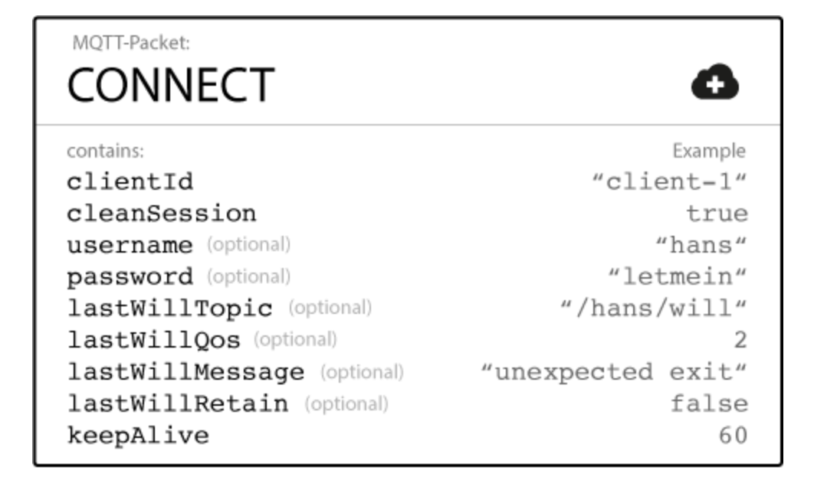
“Will” message
When clients connect, they can specify an optional “will” message, to be delivered if they are unexpectedly disconnected from the network.
(In the absence of other activity, a 2-byte ping message is sent to clients at a configurable interval.)
This “last will and testament” can be used to notify other parts of the system that a node has gone down.

Slide 38
MQTT Keep alive
The keep alive functionality assures that the connection is still open and both broker and client are connected to one another. Therefore the client specifies a time interval in seconds and communicates it to the broker during the establishment of the connection.
The interval is the longest possible period of time which broker and client can endure without sending a message.
If the broker doesn’t receive a PINGREQ or any other packet from a particular client, it will close the connection and send out the last will and testament message (if the client had specified one).
Good to Know
The MQTT client is responsible of setting the right keep alive value.
The maximum keep alive is 18h 12min 15 sec.
If the keep alive interval is set to 0, the keep alive mechanism is deactivated.

Slide 39

A few word on security
MQTT has the option for Transport Layer Security (TLS) encryption.
MQTT also provides username/password authentication with the broker.
Note that the password is transmitted in clear text. Thus, be sure to use TLS encryption if you are using authentication.

Slide 40
MQTT
Basic concepts
Basic programming

Slide 41
Software available
Brokers:
http://mosquitto.org/
http://www.hivemq.com/
A complete list here: https://github.com/mqtt/mqtt.github.io/wiki/servers
Tools
https://github.com/mqtt/mqtt.github.io/wiki/tools

Slide 42
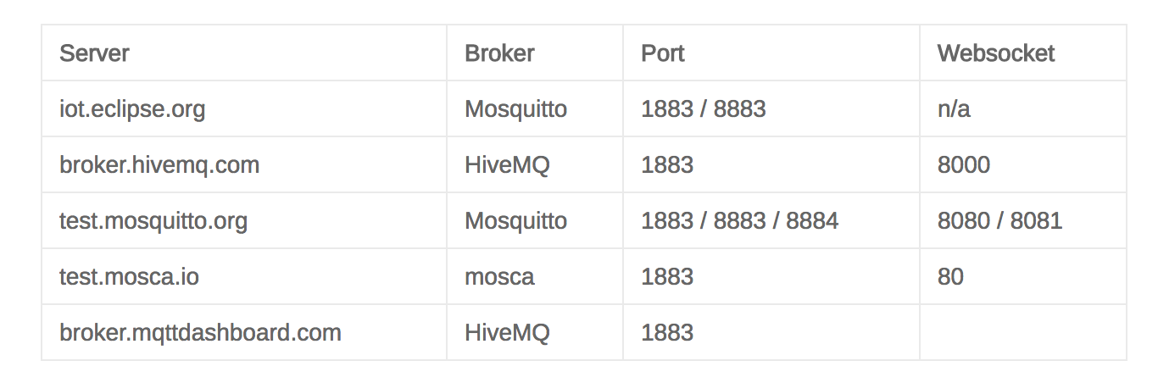
“Sandboxes” for brokers
test.mosquitto.org
http://test.mosquitto.org/
iot.eclipse.org
https://iot.eclipse.org/getting-started#sandboxes
broker.hivemq.com
http://www.hivemq.com/try-out/
http://www.mqtt-dashboard.com/
Ports:
standard: 1883
encrypted: 8883

Slide 43
Software available: clients
Clients
Eclipse Paho Python (originally the mosquitto Python client)
http://www.eclipse.org/paho/
Documentation: https://pypi.python.org/pypi/paho-mqtt
or: http://www.eclipse.org/paho/clients/python/docs/
Source: https://github.com/eclipse/paho.mqtt.python
Web Clients
https://www.hivemq.com/blog/seven-best-mqtt-client-tools
http://www.hivemq.com/demos/websocket-client/
A complete list:
https://github.com/mqtt/mqtt.github.io/wiki/libraries

Slide 44
Paho MQTT Python client: Main Methods
The client class has several methods. The main ones are:
connect() and disconnect()
subscribe() and unsubscribe()
publish()
Each of these methods is associated with a callback.
The callback is triggered by a broker response to a client command or message.
So we have:
connect() generates on_connect() callback
disconnect() generates on_disconnect() callback
subscribe() generates on_subscribe() callback
unsubscribe() generates on_unsubscribe() callback
publish() generates on_publish() callback

Slide 45
Paho MQTT Python client: general usage flow
The general usage flow is as follows:
Create a client instance
Connect to a broker using one of the connect*() functions
Call one of the loop*() functions to maintain network traffic flow with the broker
Use subscribe() to subscribe to a topic and receive messages
Use publish() to publish messages to the broker
Use disconnect() to disconnect from the broker

Slide 46
Example 1: the simplest subscriber
# File: example1.py
import paho.mqtt.client as mqtt
THE_BROKER = "test.mosquitto.org"
THE_TOPIC = "$SYS/#"
# The callback for when the client receives a CONNACK response from the server.
def on_connect(client, userdata, flags, rc):
print("Connected to ", client._host, "port: ", client._port)
print("Flags: ", flags, "return code: ", rc)
# Subscribing in on_connect() means that if we lose the connection and
# reconnect then subscriptions will be renewed.
client.subscribe(THE_TOPIC)
# The callback for when a PUBLISH message is received from the server.
def on_message(client, userdata, msg):
print(msg.topic+" "+str(msg.payload))
client = mqtt.Client()
client.on_connect = on_connect
client.on_message = on_message
client.connect(THE_BROKER, 1883, 60)
# Blocking call that processes network traffic, dispatches callbacks and
# handles reconnecting.
client.loop_forever()

Slide 47
Example 1: output
paho-code:pietro$ python example1.py
('Connected to ', 'test.mosquitto.org', 'port: ', 1883)
('Flags: ', {'session present': 0}, 'return code: ', 0)
$SYS/broker/connection/ks.ral.me.rnic/state 0
$SYS/broker/connection/Salem2.Public_Bridge/state 1
$SYS/broker/connection/RPi_MQTT_GESRV.bridgeTestMosquittoOrg/state 1
$SYS/broker/connection/br-john-jane/state 1
$SYS/broker/connection/cell_controller.bridge-01/state 1
$SYS/broker/connection/OpenWrt1504793280.test-mosquitto-org/state 1
$SYS/broker/connection/(none).test/state 0
$SYS/broker/connection/jrojoo-All-Series.test-mqtt-org/state 0
$SYS/broker/connection/archer.hive-archer/state 1
$SYS/broker/connection/MD-FelipeCoutto.test_mosquitto/state 1
$SYS/broker/connection/raspberrypi.snr-mqtt-bridge/state 0
$SYS/broker/connection/LAPTOP-TCMO862P.bridge-test-GSR01/state 0
…

Slide 48
Paho MQTT Python client
Client(client_id=””, clean_session=True, userdata=None,
protocol=MQTTv311, transport=”tcp”)
Client id [string]: can be unique or assigned
Clean Session Flag [boolean]:
This flag tells the broker to either…
Remember subscriptions and Store messages that the client has missed because it was offline value =False, or
Not to Remember subscriptions and not to Store messages that the client has missed because it was offline, value =True
Userdata:
user defined data of any type that is passed as the userdata parameter to callbacks
Transport:
‘tcp’ or `websockets’

Slide 49
Paho MQTT Python client: connect
connect(host, port=1883, keepalive=60, bind_address=””)
The broker acknowledgement will generate a callback (on_connect).
Return Codes:
0: Connection successful
1: Connection refused – incorrect protocol version
2: Connection refused – invalid client identifier
3: Connection refused – server unavailable
4: Connection refused – bad username or password
5: Connection refused – not authorised
6-255: Currently unused.

Slide 50
Paho MQTT Python client: pub/sub
subscribe(topic, qos=0)
e.g., subscribe("my/topic", 2)
E.g., subscribe([("my/topic", 0), ("another/topic", 2)])
on_message(client, userdata, message) Called when a message has been received on a topic that the client subscribes to.
def on_message(client, userdata, message):
print("Received message '" + str(message.payload)
+ "' on topic '" + message.topic + "' with QoS " + str(message.qos))
publish(topic, payload=None, qos=0, retain=False)

Slide 51
Example 1: the simplest subscriber… modified
# File: example1.py
import paho.mqtt.client as mqtt
THE_BROKER = "test.mosquitto.org"
THE_TOPIC = "$SYS/#"
# The callback for when the client receives a CONNACK response from the server.
def on_connect(client, userdata, flags, rc):
print("Connected to ", client._host, "port: ", client._port)
print("Flags: ", flags, "return code: ", rc)
# Subscribing in on_connect() means that if we lose the connection and
# reconnect then subscriptions will be renewed.
client.subscribe(THE_TOPIC)
# The callback for when a PUBLISH message is received from the server.
def on_message(client, userdata, msg):
print(msg.topic+" "+str(msg.payload))
client = mqtt.Client()
client.on_connect = on_connect
client.on_message = on_message
client.connect(THE_BROKER, 1883, 60)
# Blocking call that processes network traffic, dispatches callbacks and
# handles reconnecting.
client.loop_forever()

Slide 52
Example 1: output
paho-code:pietro$ python example1.py
paho-code:pietro$
What happened??

Slide 53
Paho MQTT Python client: Network loop
loop(timeout=1.0)
Call regularly to process network events. This call waits in select() until the network socket is available for reading or writing, if appropriate, then handles the incoming/outgoing data.
This function blocks for up to timeout seconds.
timeout must not exceed the keepalive value for the client or your client will be regularly disconnected by the broker.
Better to use the following two methods
loop_start() / loop_stop()
These functions implement a threaded interface to the network loop.
Calling loop_start() once, before or after connect (), runs a thread in the background to call loop() automatically. This frees up the main thread for other work that may be blocking.
This call also handles reconnecting to the broker. For example:
mqttc.connect("iot.eclipse.org")
mqttc.loop_start()
while True:
temperature = sensor.blocking_read()
mqttc.publish("paho/temperature", temperature)
Call loop_stop() to stop the background thread.
loop_forever()
This is a blocking form of the network loop and will not return until the client calls disconnect(). It automatically handles reconnecting.

Slide 54
Example 2: subscriber with loop
# File: example2.py
import sys
import time
import paho.mqtt.client as mqtt
THE_BROKER = "test.mosquitto.org"
THE_TOPIC = "$SYS/broker/load/bytes/#"
def on_connect(mqttc, obj, flags, rc):
print("Connected to ", mqttc._host, "port: ", mqttc._port)
mqttc.subscribe(THE_TOPIC, 0)
def on_message(mqttc, obj, msg):
print("Received ", msg.payload, "with topic ", msg.topic)
def on_publish(mqttc, obj, mid):
print("mid: ", mid)
def on_subscribe(mqttc, obj, mid, granted_qos):
print("Subscribed: ", mid, "granted QoS: ", granted_qos)
mqttc = mqtt.Client()
mqttc.on_message = on_message
mqttc.on_connect = on_connect
mqttc.on_publish = on_publish
mqttc.on_subscribe = on_subscribe
mqttc.connect(THE_BROKER, keepalive=60)
while True:
mqttc.loop()
paho-code:pietro$ python example2.py
('Connected to ', 'test.mosquitto.org', 'port: ', 1883)
('Subscribed: ', 1, 'granted QoS: ', (0,))
('Received ', '715859.78', 'with topic ', u'$SYS/broker/load/bytes/received/1min')
('Received ', '549040.48', 'with topic ', u'$SYS/broker/load/bytes/received/5min')
('Received ', '510392.06', 'with topic ', u'$SYS/broker/load/bytes/received/15min')
('Received ', '2398616.64', 'with topic ', u'$SYS/broker/load/bytes/sent/1min')
('Received ', '2188642.61', 'with topic ', u'$SYS/broker/load/bytes/sent/5min')
('Received ', '2352494.70', 'with topic ', u'$SYS/broker/load/bytes/sent/15min')
('Received ', '667690.21', 'with topic ', u'$SYS/broker/load/bytes/received/1min')
('Received ', '2674456.74', 'with topic ', u'$SYS/broker/load/bytes/sent/1min')
('Received ', '544693.38', 'with topic ', u'$SYS/broker/load/bytes/received/5min')
('Received ', '2255488.19', 'with topic ', u'$SYS/broker/load/bytes/sent/5min')
('Received ', '509394.77', 'with topic ', u'$SYS/broker/load/bytes/received/15min')
('Received ', '2373058.99', 'with topic ', u'$SYS/broker/load/bytes/sent/15min')

Slide 55
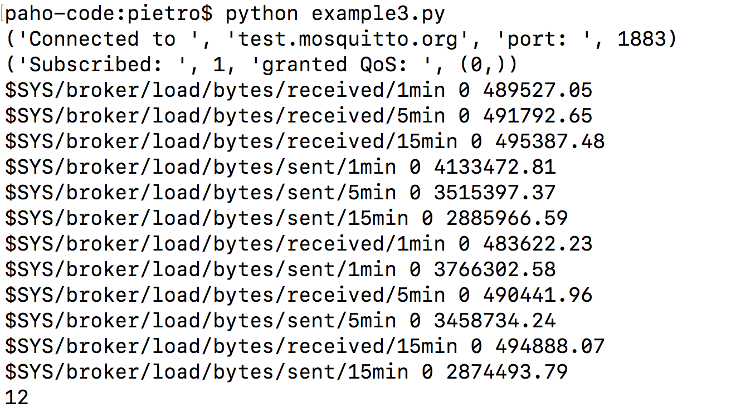
Example 3: subscriber with loop_start/loop_stop
# File: example3.py
import sys
import time
import paho.mqtt.client as mqtt
THE_BROKER = "test.mosquitto.org"
THE_TOPIC = "$SYS/broker/load/bytes/#"
def on_connect(mqttc, obj, flags, rc):
print("Connected to ", mqttc._host, "port: ", mqttc._port)
mqttc.subscribe(THE_TOPIC, 0)
def on_message(mqttc, obj, msg):
global msg_counter
print(msg.topic+" "+str(msg.qos)+" "+str(msg.payload))
msg_counter+=1
def on_subscribe(mqttc, obj, mid, granted_qos):
print("Subscribed: ", mid, "granted QoS: ", granted_qos)
mqttc = mqtt.Client()
mqttc.on_message = on_message
mqttc.on_connect = on_connect
mqttc.on_subscribe = on_subscribe
mqttc.connect(THE_BROKER, keepalive=60)
msg_counter = 0
mqttc.loop_start()
while msg_counter < 10:
time.sleep(0.1)
mqttc.loop_stop()
print msg_counter

Slide 56
Example 4: very basic periodic producer
# File: example4.py
import sys
import time
import random
import paho.mqtt.client as mqtt
THE_BROKER = "test.mosquitto.org"
THE_TOPIC = "PMtest/rndvalue"
mqttc=mqtt.Client()
mqttc.connect(THE_BROKER, 1883, 60)
mqttc.loop_start()
while True:
mqttc.publish(THE_TOPIC, random.randint(0, 100))
time.sleep(5)
mqttc.loop_stop()
paho-code:pietro$ python example2_4.py
('Connected to ', 'test.mosquitto.org', 'port: ', 1883)
('Subscribed: ', 1, 'granted QoS: ', (0,))
('Received ', '61', 'with topic ', u'PMtest/rndvalue')
('Received ', '62', 'with topic ', u'PMtest/rndvalue')
('Received ', '11', 'with topic ', u'PMtest/rndvalue')
('Received ', '79', 'with topic ', u'PMtest/rndvalue’)
…
Output obtained with a modified version of example2.
Which parts of that code had to be modified?
Generates a new data every 5 secs

Slide 57
Example 5: Pub/Sub with JSON
Producer
Consumer
# File: example5_prod.py
import json
import random
import sys
import time
import paho.mqtt.client as mqtt
THE_BROKER = "test.mosquitto.org"
THE_TOPIC = "PMtest/jsonvalue"
mqttc=mqtt.Client()
mqttc.connect(THE_BROKER, 1883, 60)
mqttc.loop_start()
while True:
# Getting the data
the_time = time.strftime("%H:%M:%S")
the_value = random.randint(1,100)
the_msg={'Sensor': 1, 'C_F': 'C', 'Value': the_value, 'Time': the_time}
the_msg_str = json.dumps(the_msg)
print(the_msg_str)
mqttc.publish(THE_TOPIC, the_msg_str)
time.sleep(5)
mqttc.loop_stop()
# File: example5_cons.py
import json
import sys
import time
import paho.mqtt.client as mqtt
THE_BROKER = "test.mosquitto.org"
THE_TOPIC = "PMtest/jsonvalue"
# The callback for when the client receives a CONNACK response from the server.
def on_connect(client, userdata, flags, rc):
print("Connected with result code "+str(rc))
# The callback for when a PUBLISH message is received from the server.
def on_message(client, userdata, msg):
print(msg.topic+" "+str(msg.payload))
themsg = json.loads(str(msg.payload))
print("Sensor "+str(themsg['Sensor'])+" got value "+
str(themsg['Value'])+" "+themsg['C_F']+
" at time "+str(themsg['Time']))
client = mqtt.Client()
client.on_connect = on_connect
client.on_message = on_message
client.connect(THE_BROKER, 1883, 60)
client.subscribe(THE_TOPIC)
client.loop_forever()
paho-code:pietro$ python example5-cons.py
Connected with result code 0
PMtest/jsonvalue {"Time": "12:19:30", "Sensor": 1, "Value": 33, "C_F": "C"}
Sensor 1 got value 33 C at time 12:19:30
PMtest/jsonvalue {"Time": "12:19:35", "Sensor": 1, "Value": 11, "C_F": "C"}
Sensor 1 got value 11 C at time 12:19:35

Slide 58
MQTT with MicroPython
Import the library
from mqtt import MQTTClient
Creating a client:
MQTTclient(client_id, server, port=0, user=None, password=None, keepalive=0, ssl=False, ssl_params={})
e.g., client = MQTTClient("dev_id", "10.1.1.101", 1883)
The various calls:
connect(clean_session=True):
publish(topic, msg, retain=False, qos=0):
subscribe(topic, qos=0):
set_callback(self, f):
wait_msg():
Wait for a single incoming MQTT message and process it. Subscribed messages are delivered to a callback previously set by .set_callback() method. Other (internal) MQTT messages processed internally.
check_msg():
Checks whether a pending message from server is available. If not, returns immediately with None. Otherwise, does the same processing as wait_msg.

Slide 59
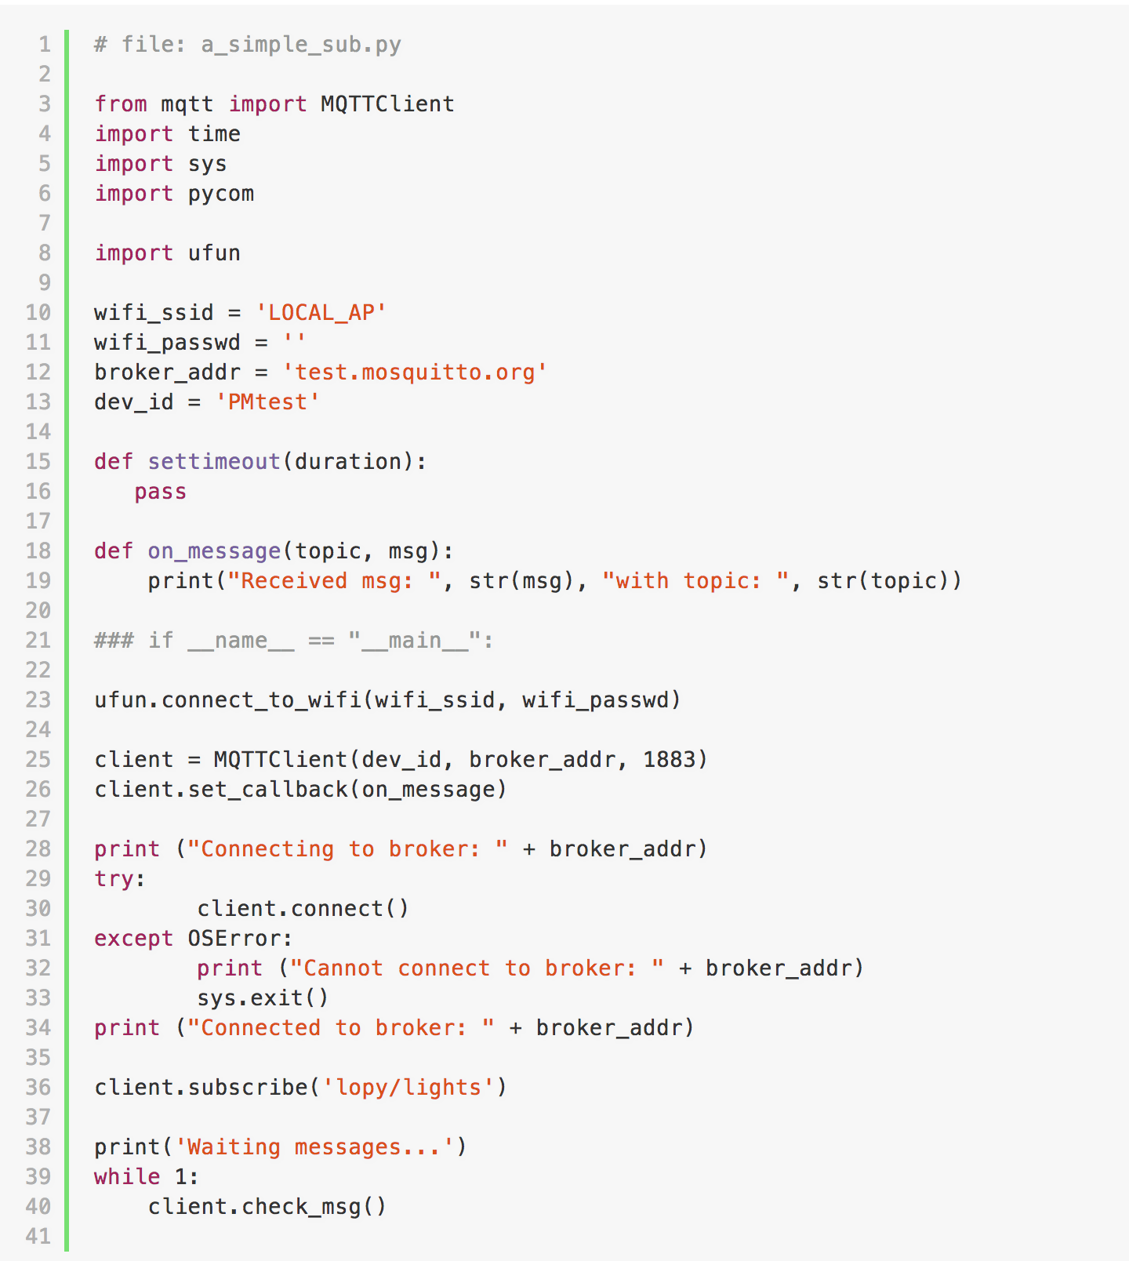
MicroPython: a simple subscriber

Slide 60
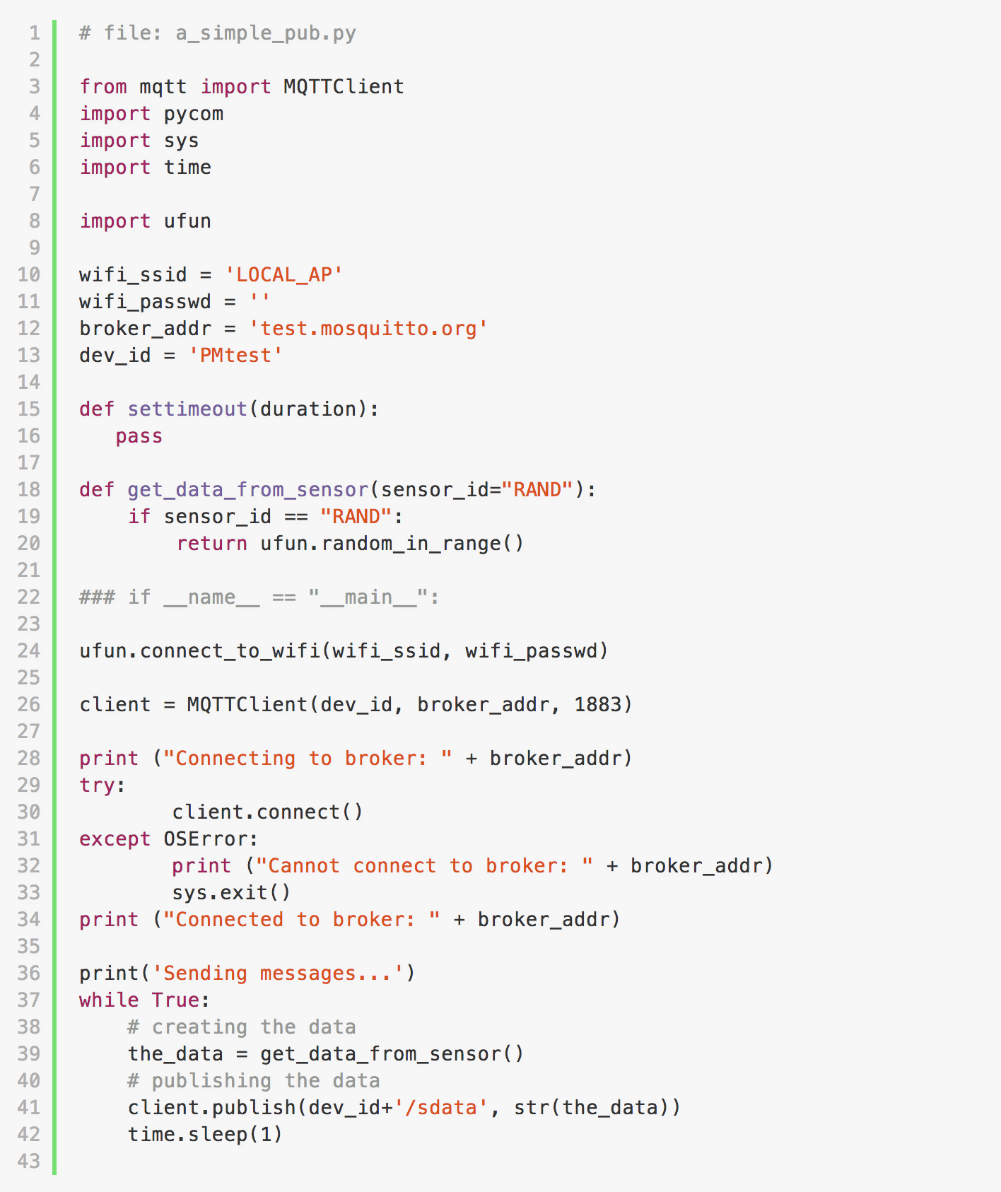
MicroPython: a simple publisher

Slide 61
REST vs MQTT

Slide 62
MQTT vs REST
Can they really be compared?!?!?
MQTT was created basically as a lightweight messaging protocol for lightweight communication between devices and computer systems
REST stands on the shoulders of the almighty HTTP
So it’s better to understand their weak and strong points and build a system taking the best of both worlds… if required

Slide 63
REST advantages
The business logic is decoupled from the presentation.
So you can change one without impacting the other.
The uniform interface means that we don't have to document on a per-resource or per-server basis, the basic operations of the API.
The universal identifiers embodied by URIs mean again that there is no resource or server specific usage that has to be known to refer to our resources
This assures that any tool that can work with HTTP can use the service.

Slide 64
REST advantages
It is always independent of the type of platform or languages
The only thing is that it is indispensable that the responses to the requests should always take place in the language used for the information exchange, normally XML or JSON.
It is stateless ➔ This allows for scalability, by adding additional server nodes behind a load balancer
Forbids conversational state. No state can be stored on servers: “keep the application state on the client.”
All messages exchanged between client and server have all the context needed to know what to do with the message.

Slide 65
REST disadvantages
Today’s real world embedded devices for IoT usually lacks the ability to handle high-level protocols like HTTP and they may be served better by lightweight binary protocols.
It is PULL based. This poses a problem when services depend on being up to date with data they don’t own and manage.
Being up to date requires polling, which quickly add up in a system with enough interconnected services.
Pull style can produce heavy unnecessary workloads and bandwidth consumption due to for example a request/response polling-based monitoring & control systems
It is based on one-to-one interactions

Slide 66
Advantages of MQTT
Push based: no need to continuously look for updates
It has built-in function useful for reliable behavior in an unreliable or intermittently connected wireless environments.
“last will & testament” so all apps know immediately if a client disconnects ungracefully,
“retained message” so any user re-connecting immediately gets the very latest information, etc.
Useful for one-to-many, many-to-many applications
Small memory footprint protocol, with reduced use of battery
It’s binary, so lower use of bandwidth… but well, depends on the payload

Slide 67
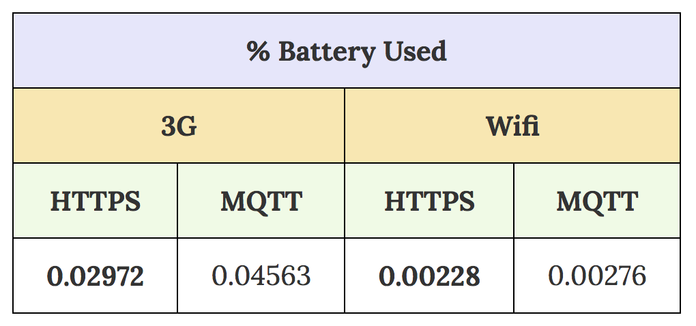
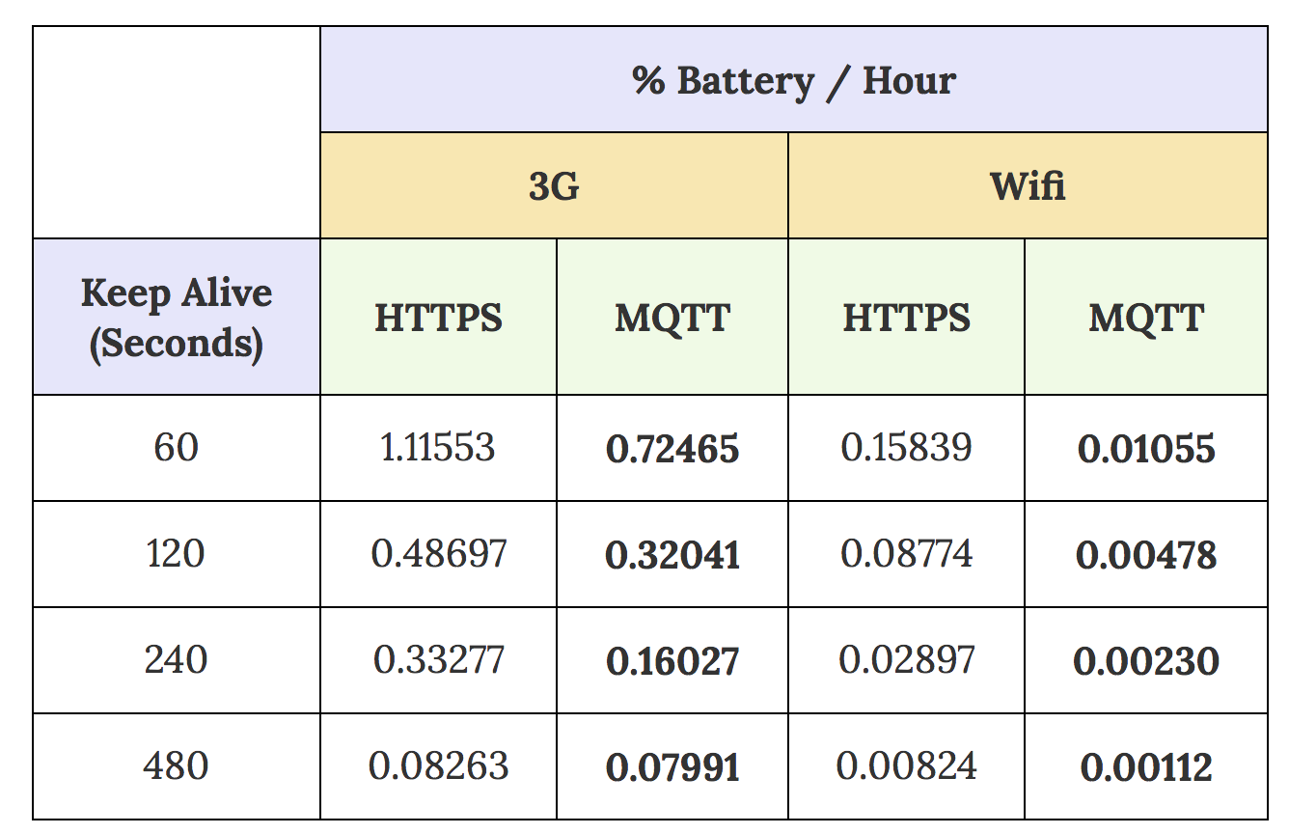
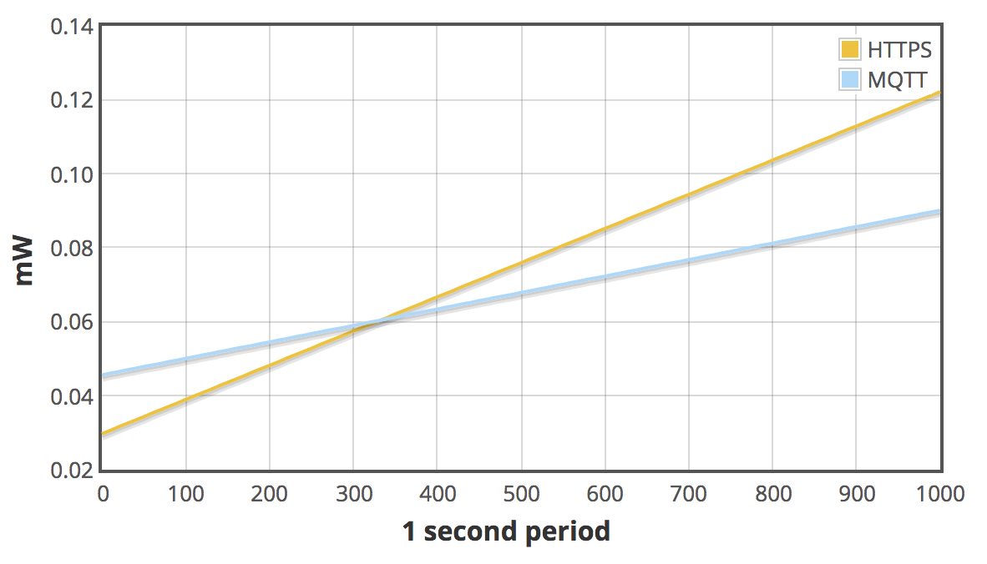
Energy usage: some number
amount of power taken to establish the initial connection to the server:
cost of ‘maintaining’ that connection (in % Battery / Hour):
3G – 240s Keep Alive – % Battery Used Creating and Maintaining a Connection
you’d save ~4.1% battery per day just by using MQTT over HTTPS to maintain an open stable connection.
http://stephendnicholas.com/posts/power-profiling-mqtt-vs-https

Slide 68
MQTT advantages: decoupling and filtering
Decoupling of publisher and receiver can be differentiated in more dimensions:
Space decoupling: Publisher and subscriber don’t need to know each other (by IP address and port for example)
Time decoupling: Publisher and subscriber do not need to run at the same time
Synchronization decoupling: Operations on both components are not halted during publish or receiving
Filtering of the messages makes possible that only certain clients receive certain messages.
MQTT uses subject-based filtering of messages. So each message contains a topic, which the broker uses to find out, if a subscribing client will receive the message or not.

Slide 69
MQTT disadvantages
Does not have a point-to-point (aka queues) messaging pattern
Point to Point or One to One means that there can be more than one consumer listening on a queue but only one of them will be get the message
Does not define a standard client API, so application developers have to select the best fit.
Does not include message headers and other features common to messaging platforms.
developers frequently have to implement these capabilities in the message payload to meet application requirements thus increasing the size of the message and increasing the BW requirements.
Does not include many features that are common in Enterprise Messaging Systems like:
expiration, timestamp, priority, custom message headers, …
Maximum message size 256MB
If the broker fails…

Slide 70
So, trying to summarize
REST
Advantages
Uniform and very widely adopted interface
The business logic is decoupled from the presentation
Allows to retrieve any historical data
Disadvantages
It’s pull based
One-to-one interaction
Too heavy for small devices (see CoAP)
MQTT
Advantages
Push based: no need to continuously look for updates
Useful for one-to-many, many-to-many applications
Small memory footprint protocol, with reduced use of battery
Built-in function useful for reliable behavior in an unreliable or intermittently connected wireless environments
Disadvantages
Does not define a standard client API
Does not have a point-to-point messaging pattern
Not much sense of history…
If the broker fails…

